Slide 1
Dimensional Model in Erwin
MIS 634
Business Intelligence & Data Integration - LAB

Slide 2
What is Dimensional Model
Dimensional modelling is a special approach to modelling data
It separates business process data into facts
It contains one table with a multipart key, called the fact table
It contains a set of smaller tables, called dimension tables
Each dimension table has a single-part primary key that corresponds exactly to one of the components of the multipart key in the fact table
It is designed for reading, summarizing and analyzing numeric information
It is a denormalization technique

Slide 3
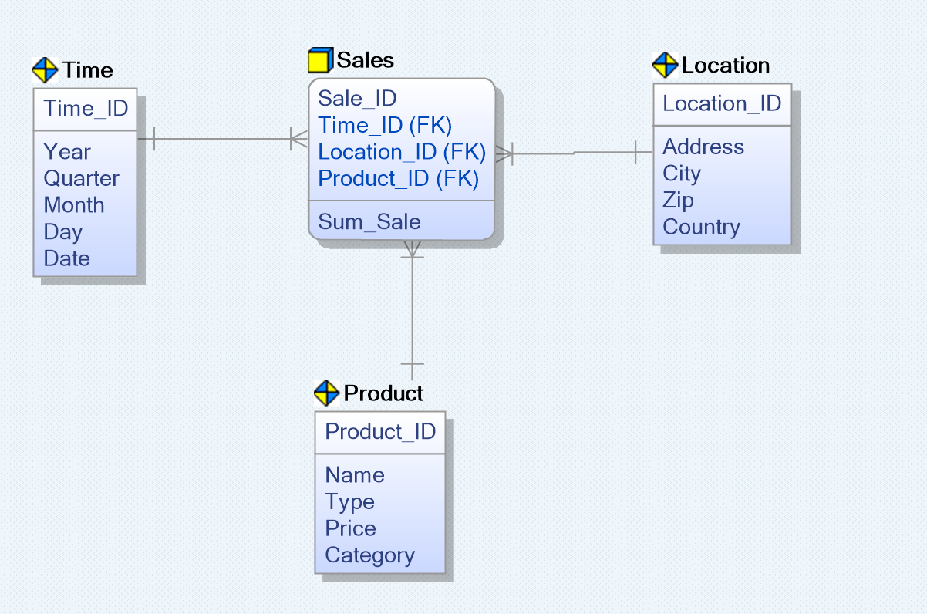

Dimensional Model Diagram
Facts: numerical values, data that is being analyzed
A sample of dimensional model
Fact Table
It is a “star” schema.
( We will talk about it)
Denormalized
Dimension Tables: descriptive attributes related to fact data

Slide 4
Steps of Dimensional Modelling
Identify Business Process
Identify Grain (level of detail)
Identify Dimensions
Identify Facts
Build Schema

Slide 5
Steps of Dimensional Modelling
Identify Business Process
Identifying the actual business process a data warehouse should cover.
This could be Marketing, Sales, HR, etc. as per the data analysis needs of the organization.
Example: The CEO at an MNC wants to find the sales for specific products in different locations on a daily basis. -> Sales

Slide 6
Steps of Dimensional Modelling
2. Identify the Grain
It is the process of identifying the lowest level of information for dimension tables.
Example: The CEO at an MNC wants to find the sales for specific products in different locations on a daily basis. The Grain is “by product; by location; by the day.”

Slide 7
Steps of Dimensional Modelling
3. Identify the Dimension
Dimension table is table which describes the business entities of an enterprise which describes the objects in a fact table.
Dimension table has primary key which uniquely identifies each dimension rows.
Example of Dimension: Dimensions: Product, Location and Time Attributes: For Product: Product ID, Name, Type, Price, etc.; For Location: Location ID, Country, State, City, Address, etc.; For Time: Time ID, year, quarter, month, and day.

Slide 8
Steps of Dimensional Modelling
4. Identify the Fact
Fact table is central table found in star schema or snowflakes schema which is surrounded by dimension tables.
Fact table contains numeric values that are known as measurements (most useful: numeric and additive).
Example of Fact: The CEO at an MNC wants to find the sales for specific products in different locations on a daily basis. The fact here is Sum of Sales by product, by location, and by time.

Slide 9
Steps of Dimensional Modelling
5. Build Schema
Star Schema
Snowflake Schema

Slide 10
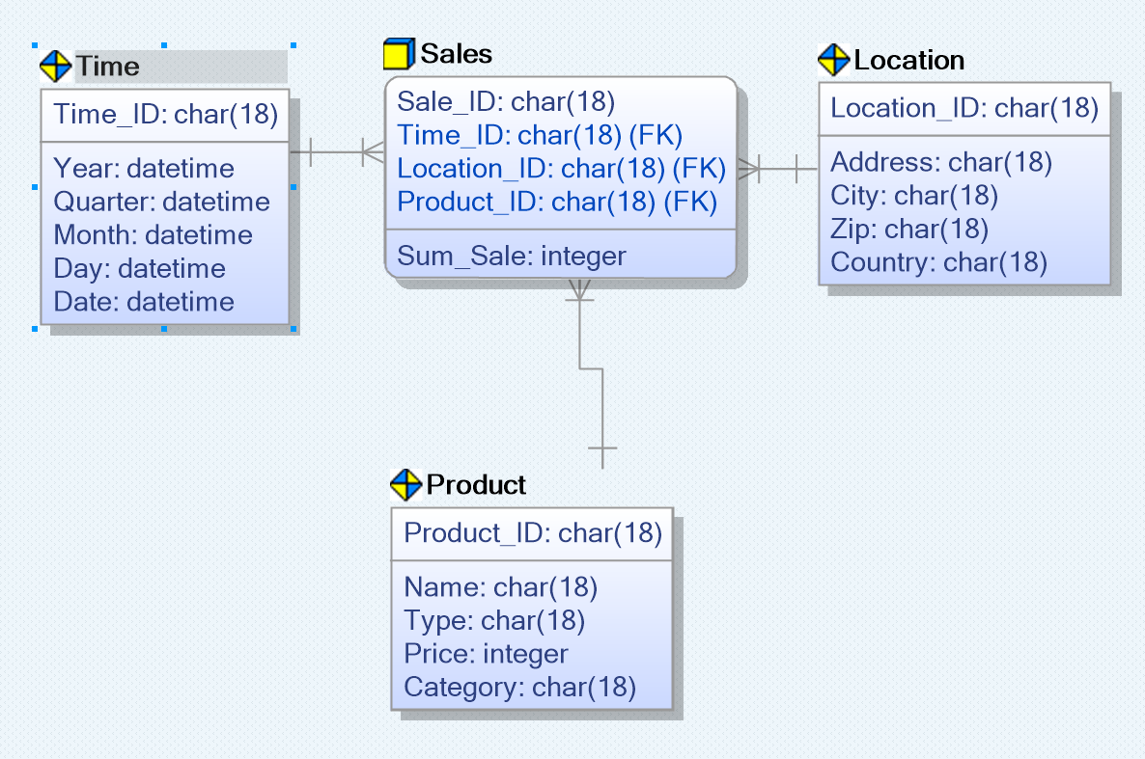
Operation Tips
Normally, we use “physical” for dimensional model
Create tables, define primary key and attributes as what we did before

Slide 11
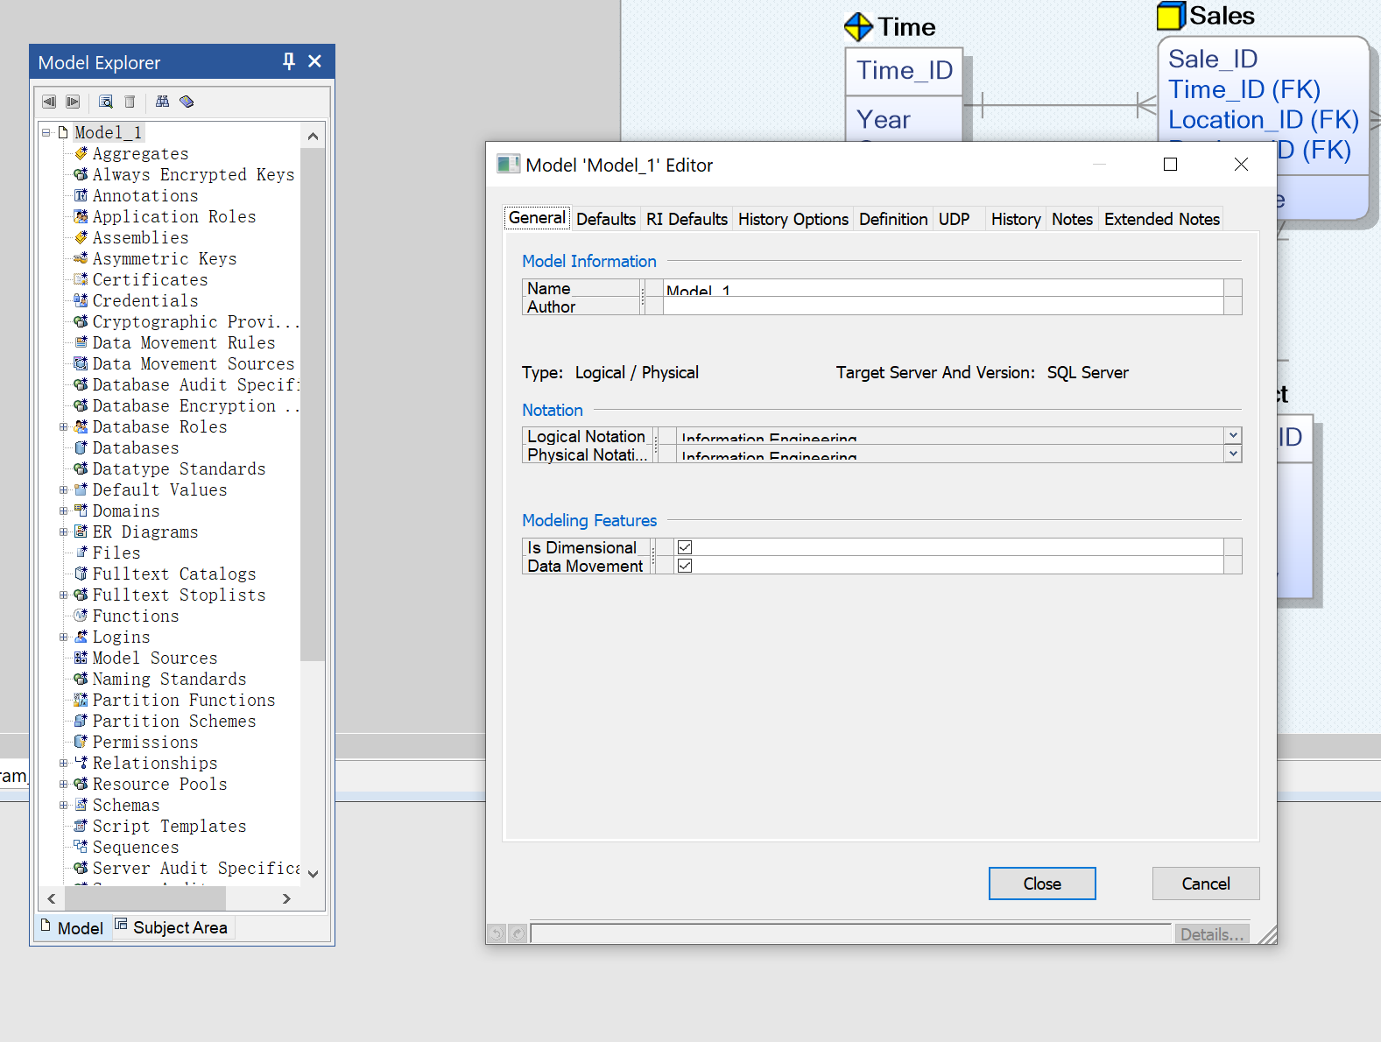

Operation Tips
Make a Dimensional Model
Right Click Here
Check this box

Slide 12
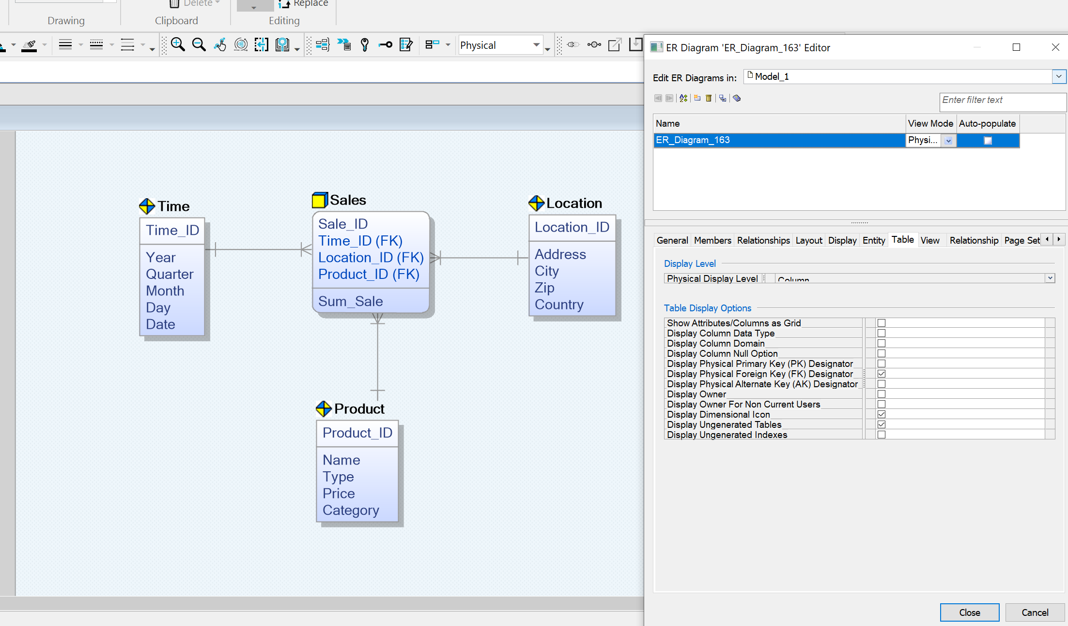
Operation Tips
Display Dimensional Icon
Check this box
Right click at a blank area

Slide 13
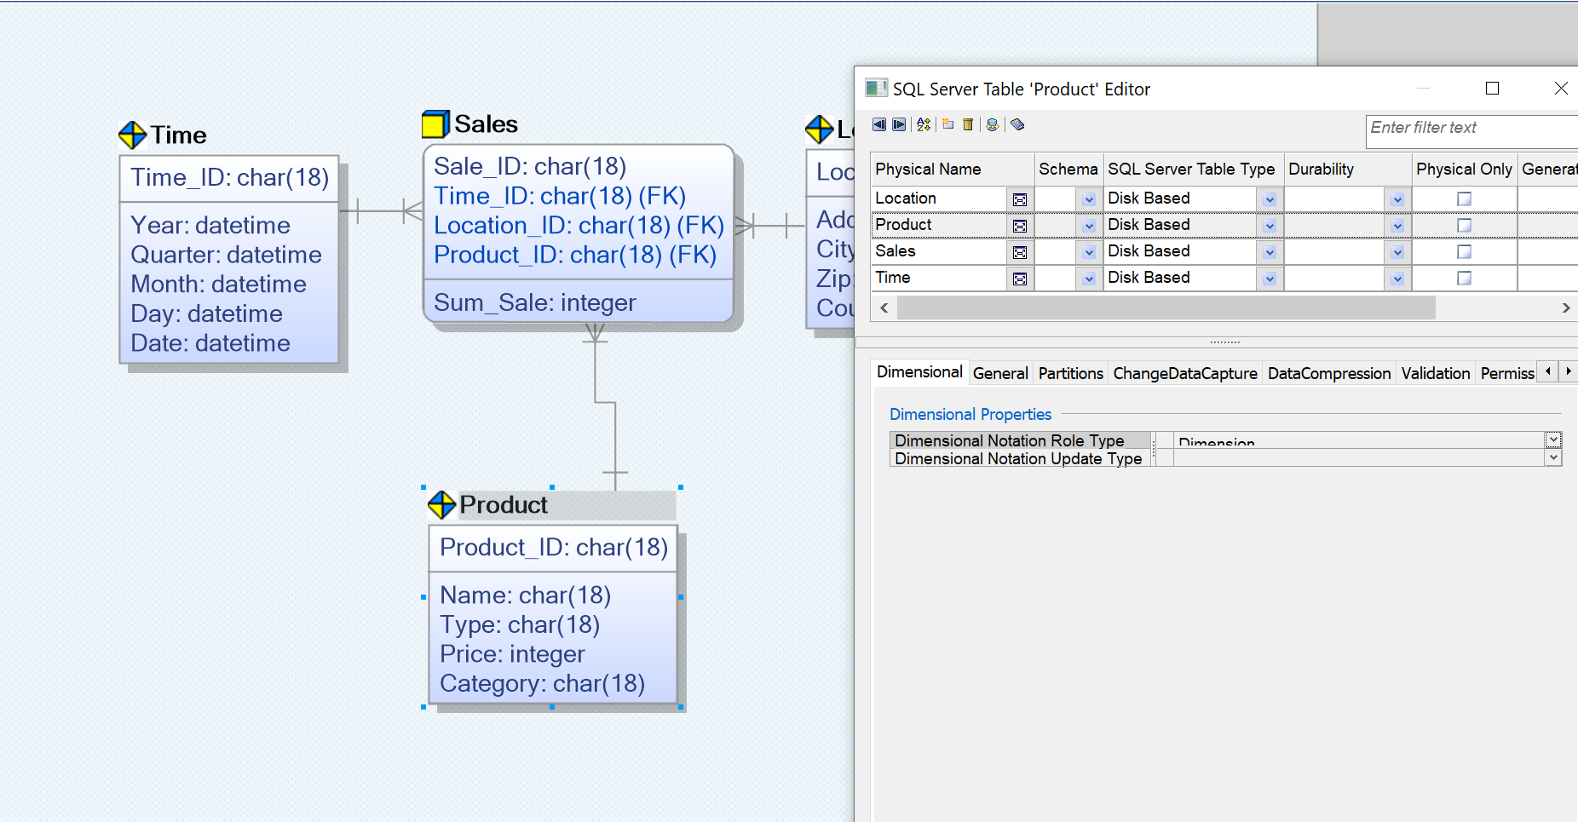

Operation Tips
Manually Change Role Type
Options
Right click at Table

Slide 14
Exercise 1
Reading：The data warehouse toolkit
Chapter 2: Retail Sales
Chapter 3: Inventory

Slide 15
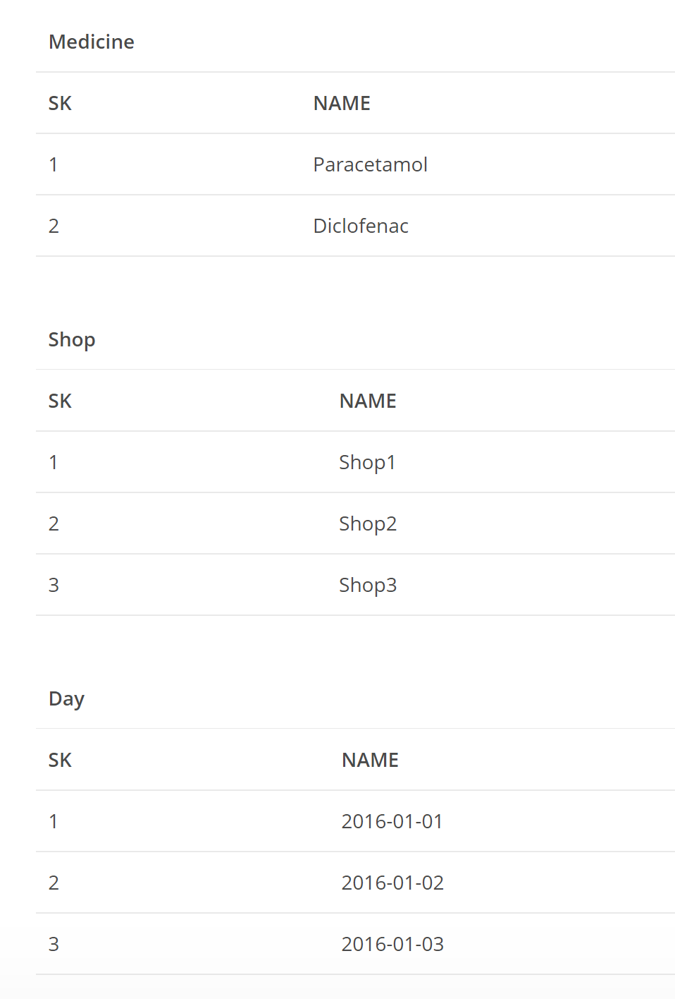
Exercise 2
You have these three data tables (shown in right side), and you want to store the information of how many paracetamol and diclofenac tablets sold from single MedPlus store every day.
Please create a proper dimensional model.

Slide 16
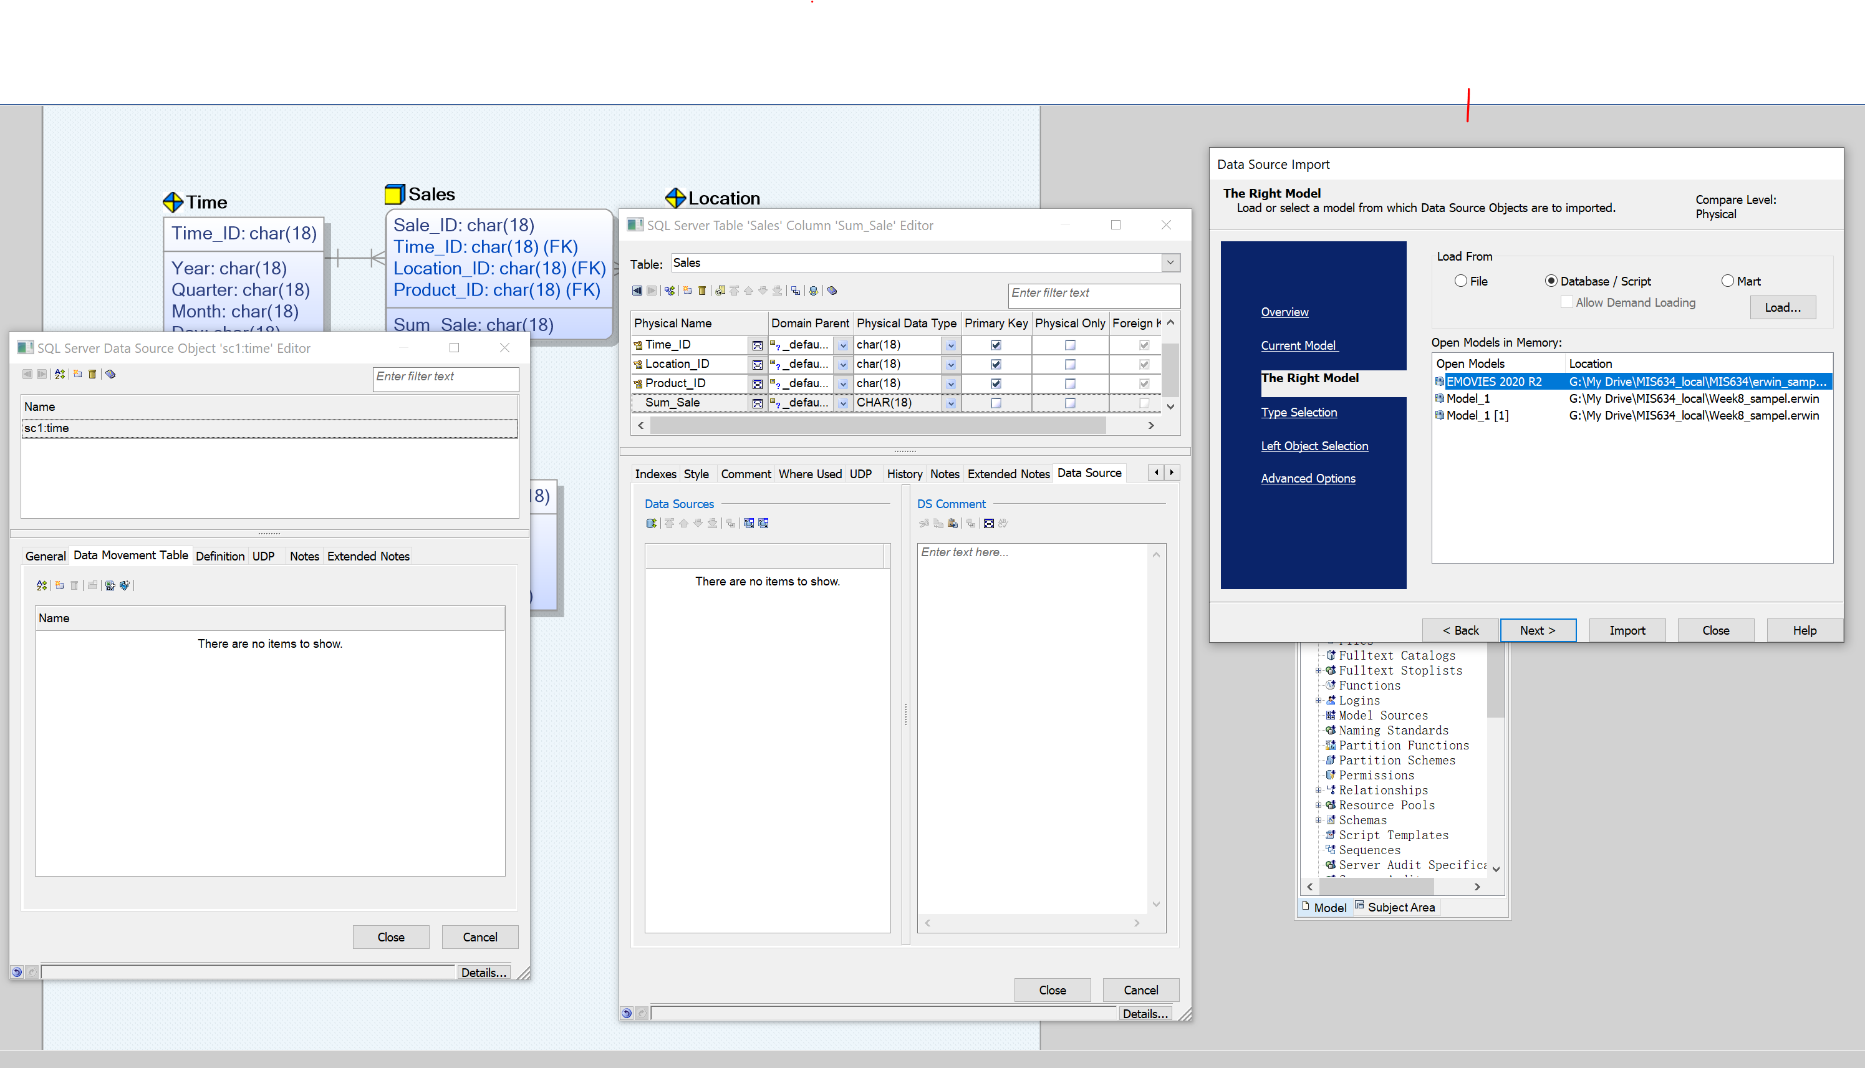

Backup: Data Movement not Available
1. Select the column

Slide 17
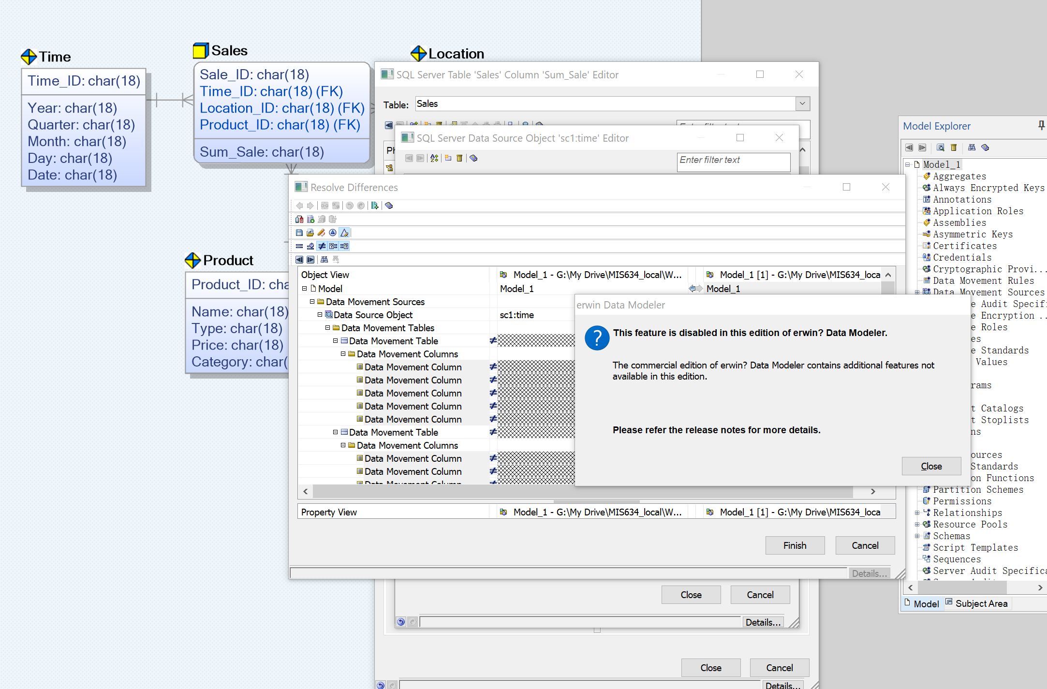
Backup: Data Movement not Available
Not available

Slide 18
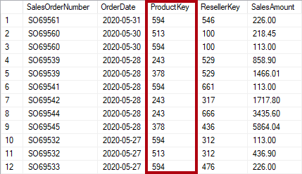
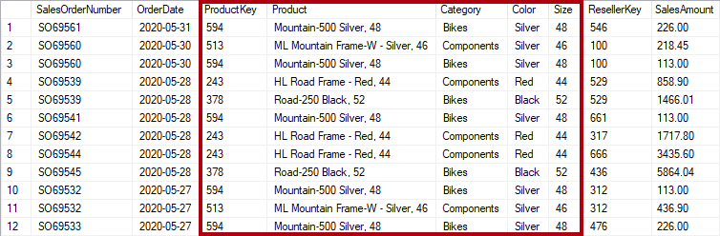
Backup: Normalized V.S. Denormalized

Slide 19
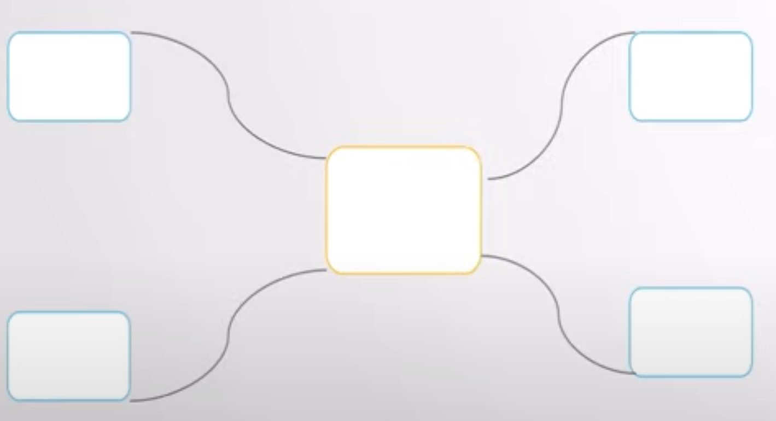
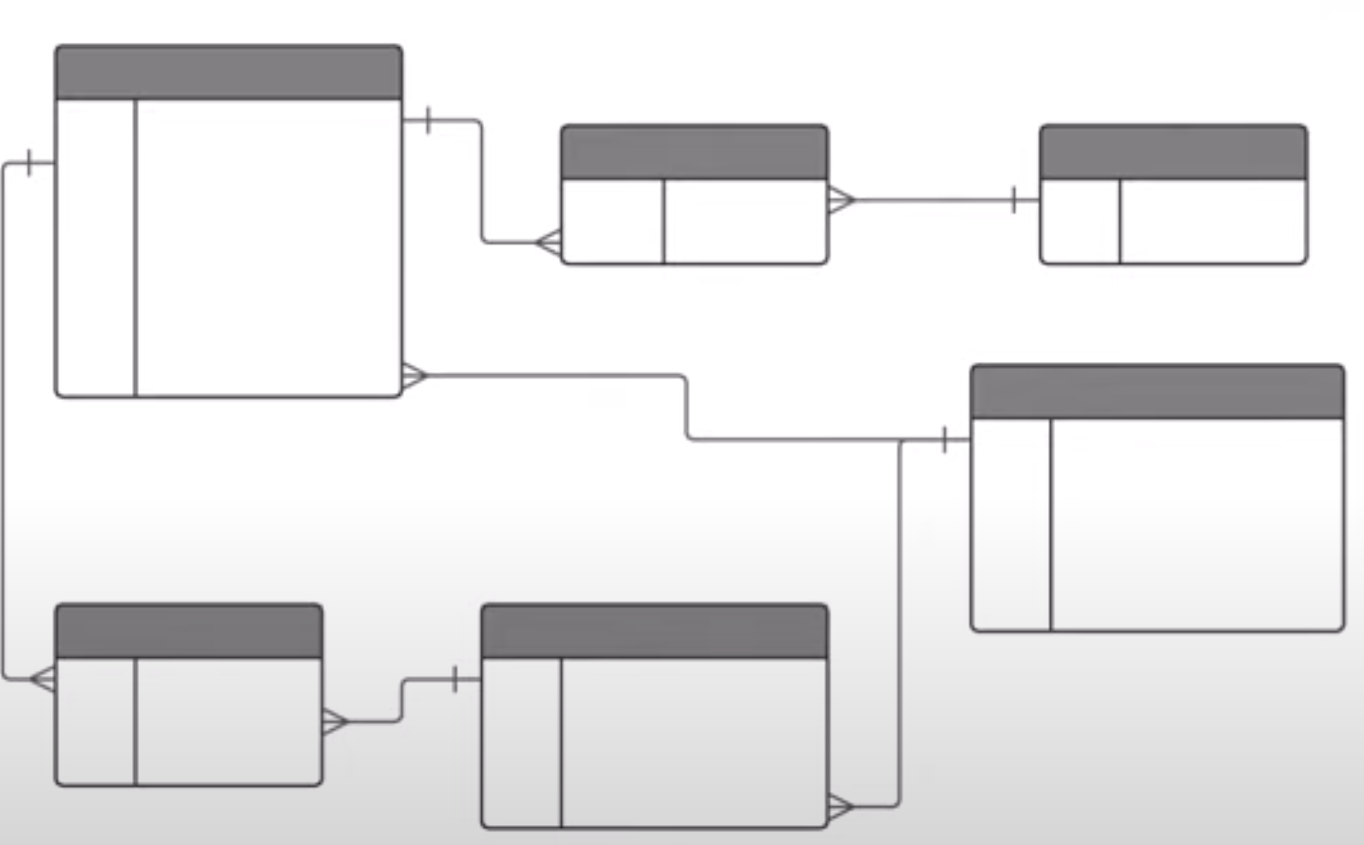
Backup: Dimensional Model V.S. ER Model
 | Dimensional Model | ER Model
Purpose | Reporting (OLAP system) | Transactional System (OLTP system)
Operation | Mostly Select | Transitional Operating ( Delete/ Inset/ Update/ Select)
Best Usage | Fast retrieval/ Simplicity | Less redundant data/ Improve data integrity
Structure | Less Complex | Complex
Type | De-normalized | Normalized

